Slide 1
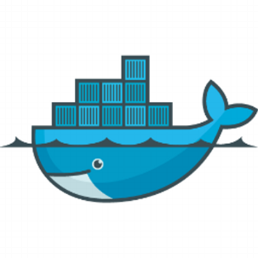
Docker Fundamentals
Suman Debnath

Slide 2
Agenda
Introduction to Virtualization Technologies
Container based Virtualization
Docker Architecture
Docker based Web-Application

Slide 3
It’s all about Applications

Slide 4
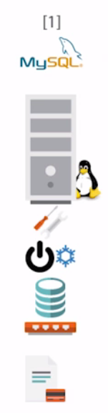
Server : Application 1 : 1

Slide 5
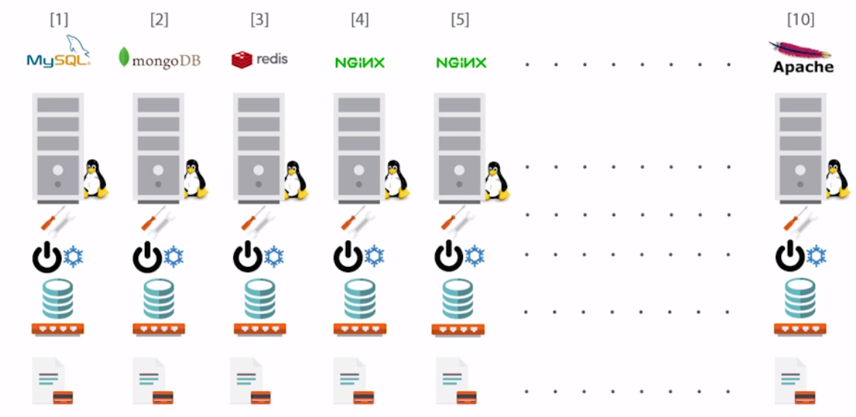
Server : Application 1 : 1

Slide 6
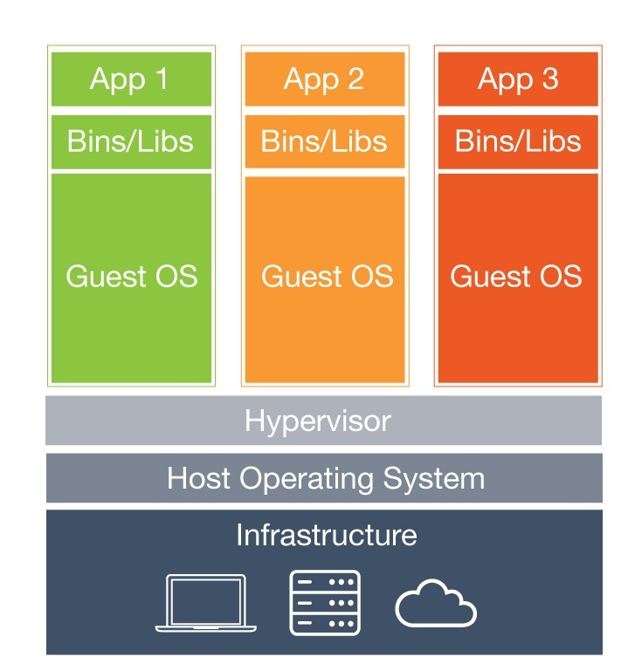
Hypervisor
Beneﬁts:
Cost-Eﬃcient
Easy to Scale
Limitations:
Separate Guest OS
Application Portability Issue

Slide 7
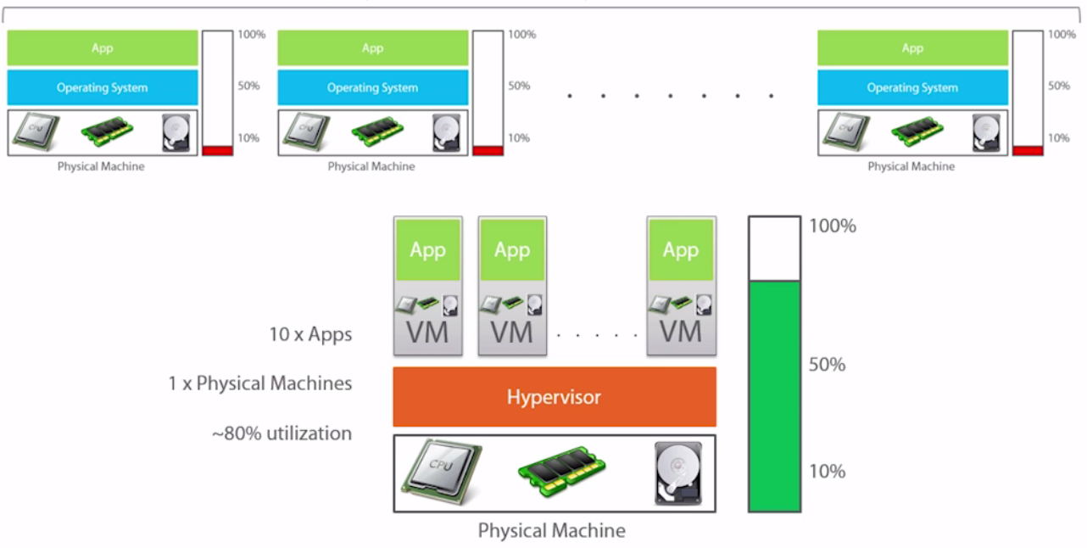
Server : Application 1 : 10
Previously
Now

Slide 8
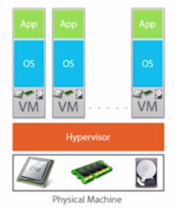
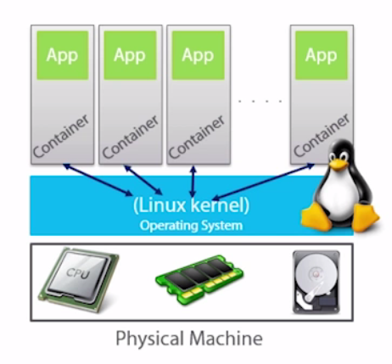
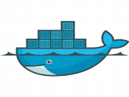
Containers
VM Model

Slide 9
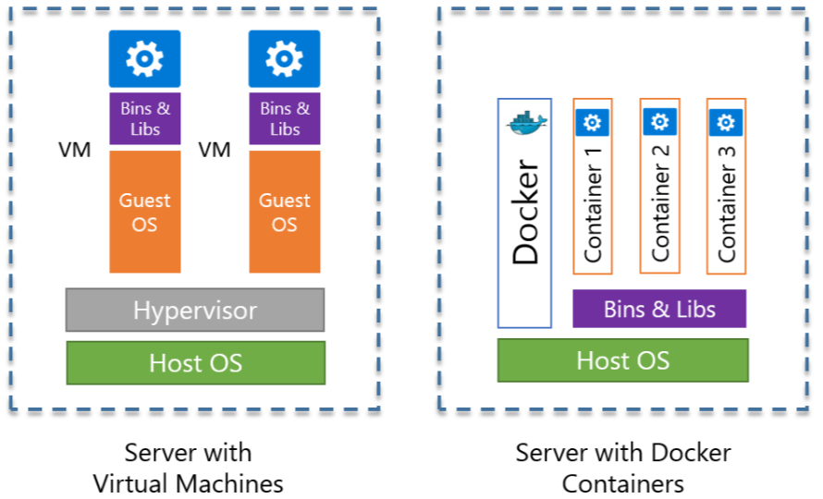
Docker

Slide 10
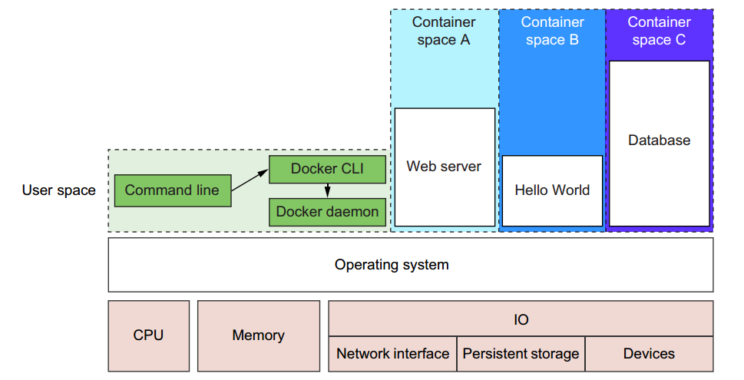
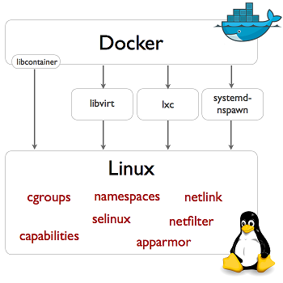
Docker (Underlying Technology)
Container1
Container2
Container3

Slide 11
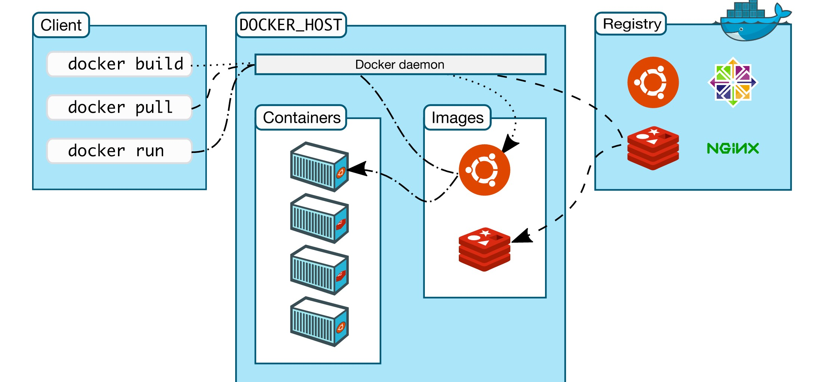
Docker Architecture
Same or different Server

Slide 12
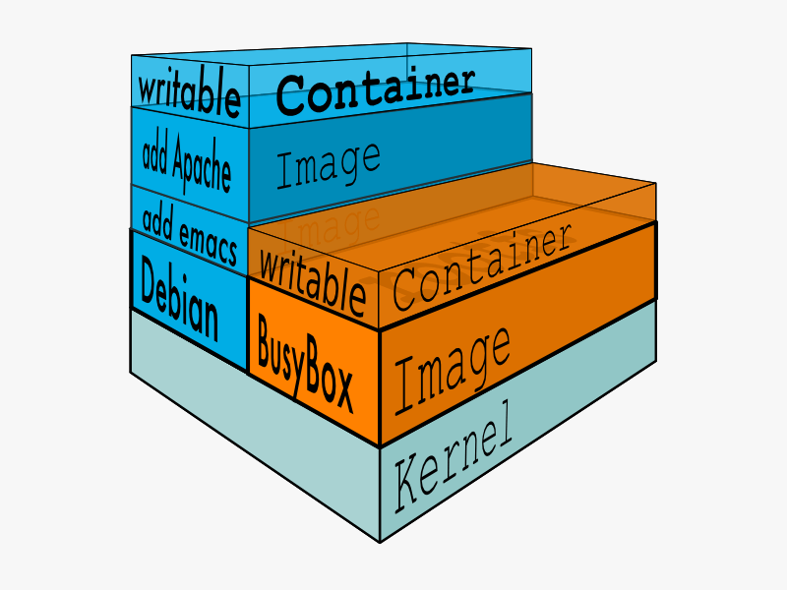
Images
Images are read only templates used to create containers
Images are composed of layers of other images
Images are stored in a Docker registry

Slide 13
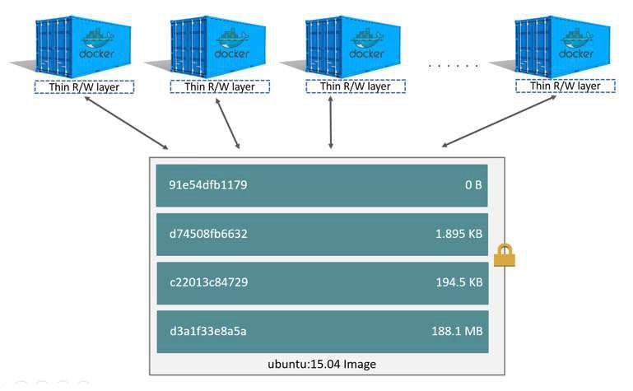
Image Layers

Slide 14
Installation

Slide 15
Demo

Slide 16
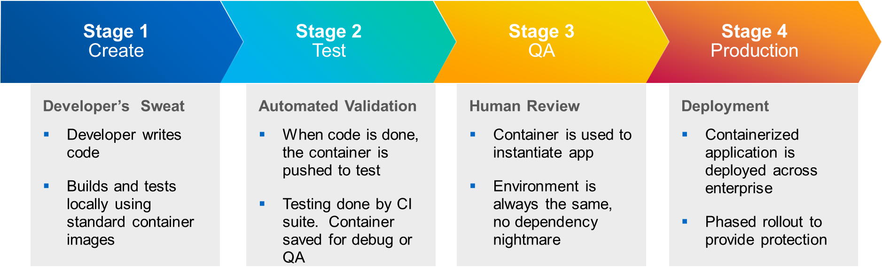
Docker for Developers
Application deployment – ship, test, and deploy code faster
For DevOps

Slide 17
What Next..
Docker
Docker Hub
The Docker Book
Tutorials
Cloud Computing for Developers
Deploying & Managing Scalable Web Applications in the Cloud
Best Practices for Running Production Applications in the Cloud

Slide 18





Let’s stay connected…
github.com/suman-d
suman.san14@yahoo.in
linkedin.com/in/suman-d
+91-9620102221

